Slide 1
The Writing Process In Business Communication

Slide 2
Revising Business Messages
Objectives
Understand the revision phase of the writing process and employ techniques that enhance message conciseness
Revise messages to improve clarity
Revise messages to improve vigor and directness
Document design should have white space, margins , bulleted lists, and headings to improve readability
Apply effective techniques for proofreading routine and complex documents

Slide 3
The process of revision
“Revising” means improving the content and sentence structure of your message
“Proofreading” involves improving the grammar, spelling, punctuation, and mechanics of your messages

Slide 4
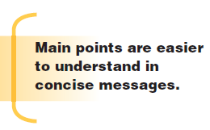
Revising for conciseness
Eliminating Flabby expressions
e.g. “Due to the fact that sales are booming, profits are good”
“Because sales are booming, profits are good”
limiting long lead-ins
e.g. “I am sending you this e-mail to announce that a new manager has been hired”
“A new manager has been hired”

Slide 5
Revising for conciseness
Dropping unnecessary There is/are and It is/was Fillers
e.g. “There is only one candidate who passed the test”
“Only one candidate passed the test”
Getting rid of redundancies
“The use of words whose meanings are clearly implied by other words is a writing fault called redundancy”
e.g.

Slide 6
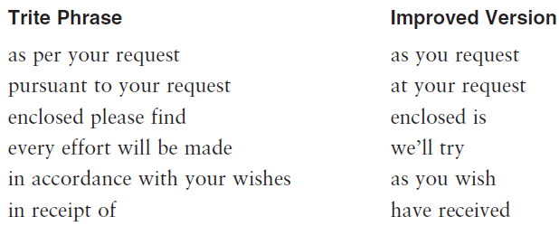
Revising for clarity
Techniques that improve clarity include,
Dumping Trite Business phrases
e.g.
Avoiding Jargon and slang
e.g. Engineers are familiar with phrases such as infrared processing flags, output latches, and movable symbology (Jargon) and avoid expressions such as snarky, lousy, blowing the budget, bombed, and getting burned (slang).

Slide 7
Revising for clarity
Dropping clichés
Clichés are expressions that have become exhausted by overuse
Clichés lack not only freshness but also clarity
e.g.

Slide 8
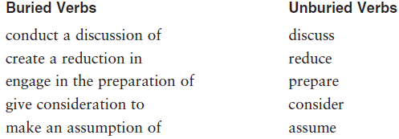
Revising for Vigor and Directness
You can also strengthen the vigor and directness of your writing by,
Unburying Verbs
Buried verbs are those that are needlessly converted to wordy noun expressions
When verbs such as acquire, establish, and develop are made into nouns such as acquisition, establishment, and development
e.g.

Slide 9
Controlling exuberance
Occasionally we show our exuberance with words such as very, definitely, quite, completely, extremely, really, actually, and totally
e.g.

Slide 10
Choosing clear, precise words
Clear writing creates meaningful images in the mind of the reader
Such writing is sparked by specific verbs, concrete nouns, and vivid adjectives
e.g.

Slide 11
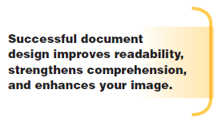
Designing Documents for readability
Employing White space
Empty space on a page is called white space
To increase white space, use headings, bulleted or numbered lists, short paragraphs, and effective margins
Be sure, however, that each part of the divided paragraph has a topic sentence

Slide 12
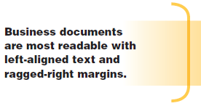
Designing Documents for readability
Understanding margins and text alignment
Business letters and memos usually have side margins of 1 to 1½ inches
Your word processing program probably offers these forms of margin alignment:
(a) lines aligned only at the left,
(b) lines aligned only at the right
(c) lines aligned at both left and right (justified)
(d) centered lines

Slide 13
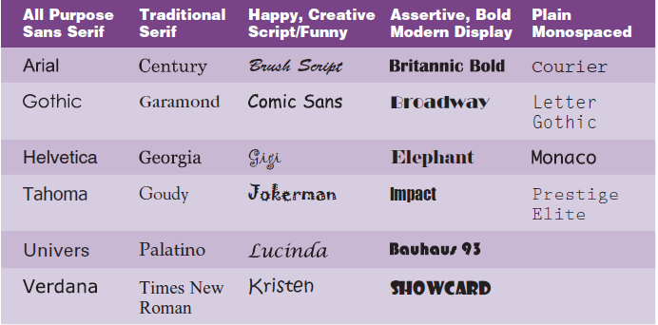
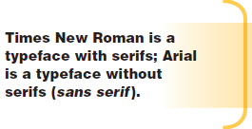
Designing Documents for readability
Choosing appropriate Typefaces
A typeface defines the shape of text characters
Most business messages use serif or sans serif

Slide 14
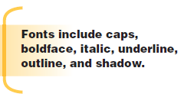
Designing Documents for readability
Capitalizing on Type Fonts and sizes
Font refers to a specific typeface in a specific style, as shown in these examples,
Typeface: Time Roman Font: Times Roman italic

Slide 15
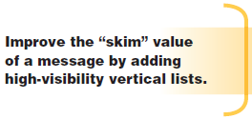
Designing Documents for readability
Numbering and Bulleting lists
By breaking up complex information into smaller chunks, lists improve readability, understanding, and retention
Look for items that could be converted to lists and follow these techniques to make your lists look professional,
(a) Numbered lists
(b) Bulleted lists
(c) Capitalization
(d) Punctuation
(e) Parallelism

Slide 16
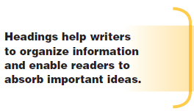
Designing Documents for readability
Adding headings for visual impact
For example, bulleted information summarize categories:
Category Headings
Our company focuses on the following areas in the employment process:
Attracting applicants
Interviewing applicants
Checking references

Slide 17
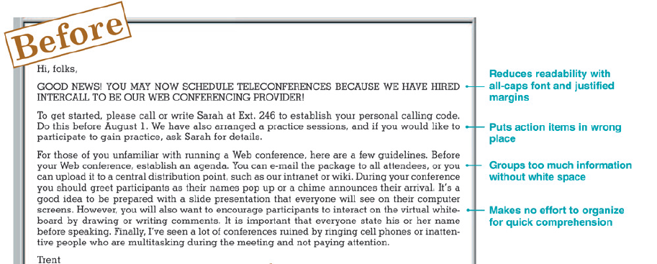
Example: Document Design to Improve Readability

Slide 18
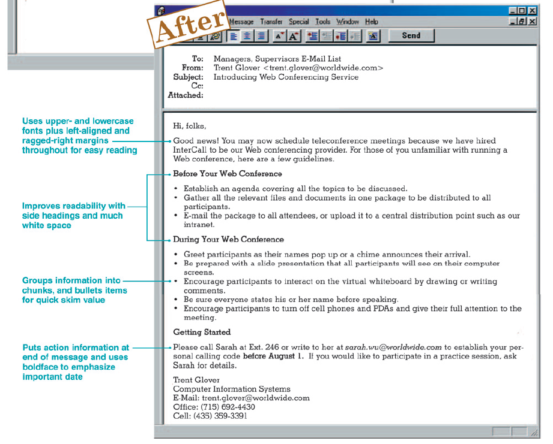
Example: Document Design to Improve Readability

Slide 19
Understanding the process of proofreading
Once message is finalized, set aside time to proofread.
What to Watch for in proofreading ?
Spelling
Grammar
Punctuation
Names and numbers
Format
Note : Double-check your use of semicolons and colons

Slide 20
Understanding the process of proofreading
How to proofread routine Documents ?
Most routine messages, including e-mails, require a light proofreading
Read carefully for faults such as omitted or doubled words
A safer proofreading method is reading from a printed hard copy
Take a close look at bad line endings, strange page breaks, and weird spacing

Slide 21
Understanding the process of proofreading
How to proofread complex Documents ?
Long, complex, or important documents demand more careful proofreading using the following techniques,
Print a copy
Allow adequate time to proofread carefully
Be prepared to find errors
Read the message at least twice
Reduce your reading speed
Read the message aloud
Use standard proofreading marks
Use computer word program to check readability level

Slide 22
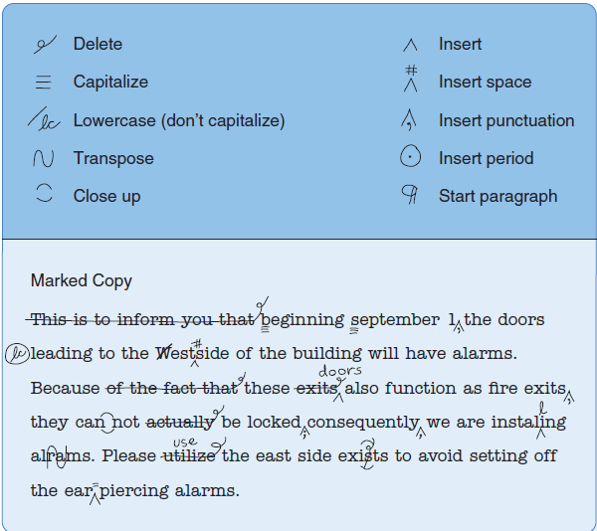
Understanding the process of proofreading
Example : Proofreading Marks

Slide 23
Your Task
Divide into two-person teams. Each partner edits the Grammar/Mechanics Challenge letter. Edit the letter, making all necessary corrections. Save the letter with a file name such as YourName-2k10. Send an e-mail message to your partner with the attached file and ask your partner to make any further edits. the receiving partner uses font color, strikethrough, and the Comment feature to edit the partner’s message. Print a copy of your partner’s edited letter before you edit it. Submit that copy along with a copy of your partner’s letter with your edits. Be sure to label each carefully.
Deadline : 28-May-2013

